Slide 1
Q1 2014 CAR Analysis
Team:
Alan Purvey
Julie Heinzinger
Mark Jessen
CAR Number: 133912654
CAR Number: 133911539
CAR Number: 133912730
CAR Number: 133912451

Slide 2
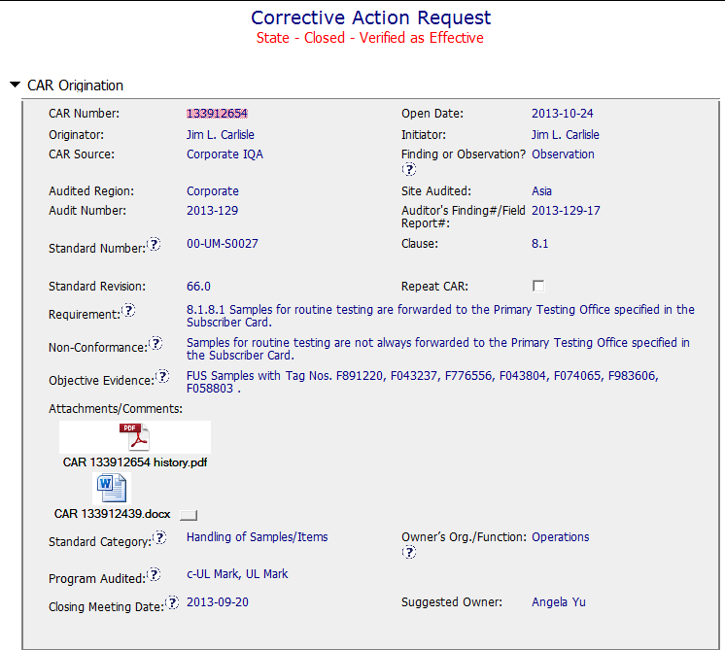
Observation:
Background
Could provide more specific detail of the evidence.
Sample Size to justify Observation?
Detailed analysis attached.

Slide 3
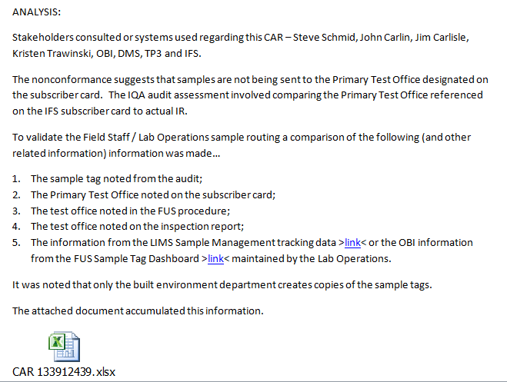
Owner
response
Page 1 of analysis showing stakeholders. Several pages of details and attachments follow.

Slide 4
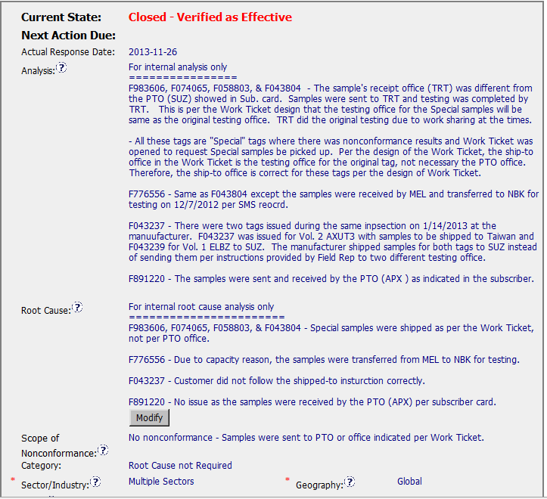
Analysis and Root Cause not required for an Observation.
Confused by “No nonconformance” since there is a Corrective Action.

Slide 5
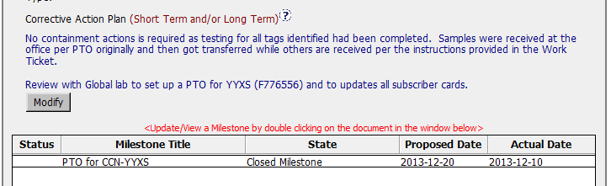
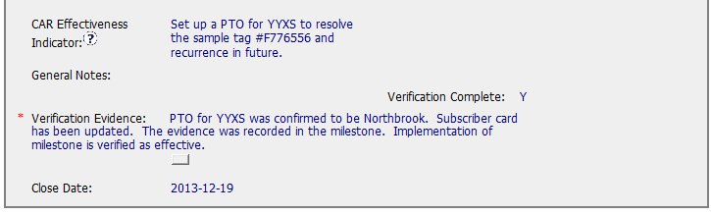
Observation 133912654
Analysis indicated that most issues were actually in compliance. Only one action to correct a PTO for YYXS was required to fix the issue.
Action is verified and Observation is closed.
Question?
Was this CAR originally a Finding, then changed to an Observation based on the Analysis?

Slide 6
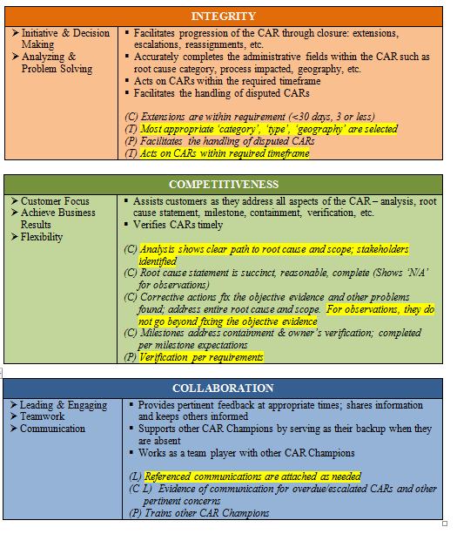
Observation 133912654

